Slide 1
Big Mart Sales Prediction
Under the guidance of Prof. Shruti Agrawal
Group Members:
1. Prashik Nikumbe (18101A0040)
2. Soham Lohar (18101A0042)
3. Yash Waghmare (18101A0049)

Slide 2
Introduction
Now a days, Malls are getting more serious and aggressive only due to the rapid growth of the global malls and online shopping.
Traditional ways of predicting sales are not that much reliable.
Machine learning provides better way for predicting the sales
Machine Learning models are more adaptable and can handle non linear data.
It can also handle big data.
We are using models like Linear regression, Lasso Regression, Ridge Regression, Random Forest and Xgboost for sales prediction.

Slide 3
Problem Definition
Traditional sales prediction techniques are limited to only the available demand history, have less accuracy, focuses on few demand factors and has less scope.
It can be easily overcome by machine learning models
Our aim is to train and test machine learning models for sales prediction.
Also to compare the various models and find the best one.

Slide 4
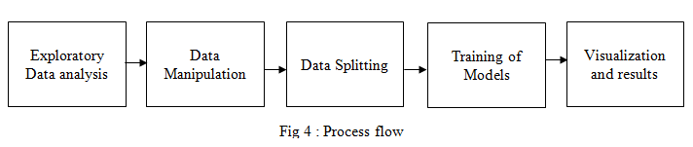
Methodology
We have found the big mart sales data on Kaggle and we have pre-processed the data before using it for training and testing the models.
The steps we consider in our projects are Exploratory analysis of the data, Data Manipulation, Data Splitting, Training Models, Visualization and results.
We are comparing the trained models by RMSE value.

Slide 5
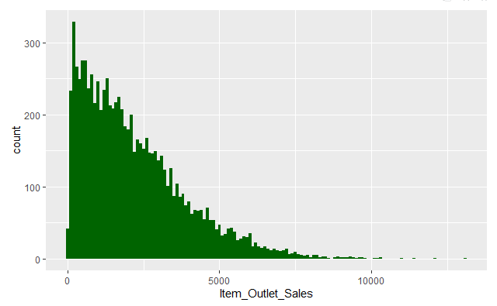
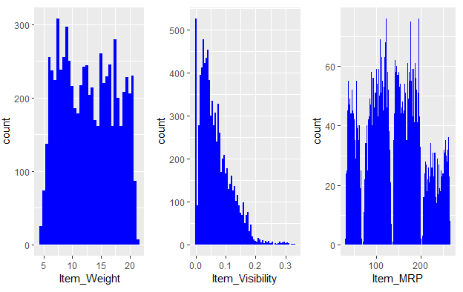
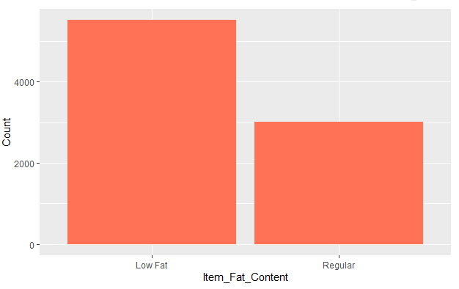
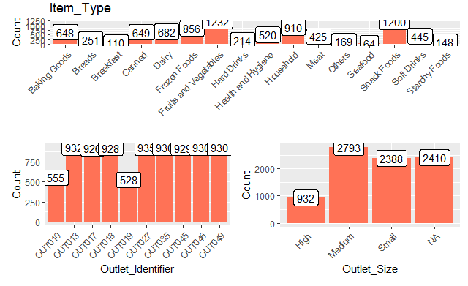
Result and Discussion

Slide 6
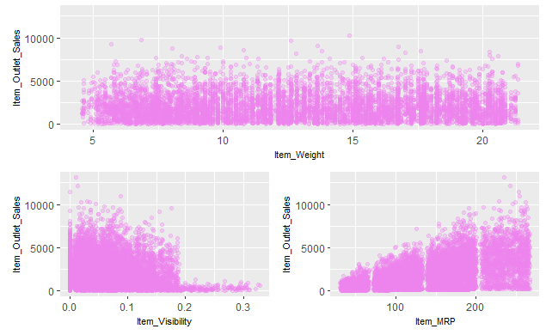
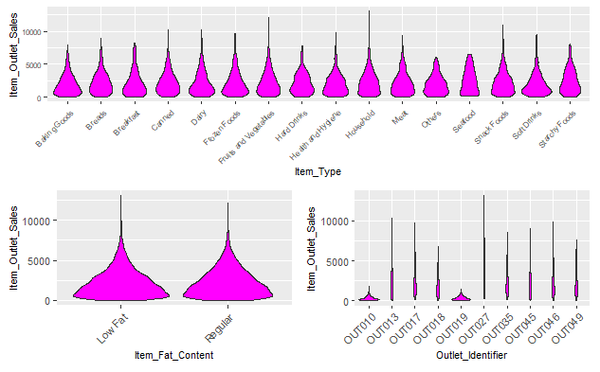
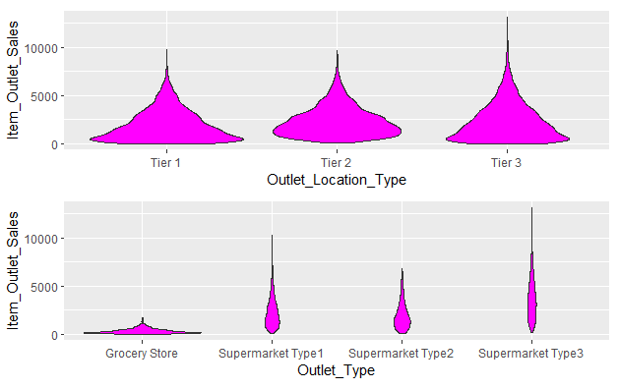
Continue

Slide 7
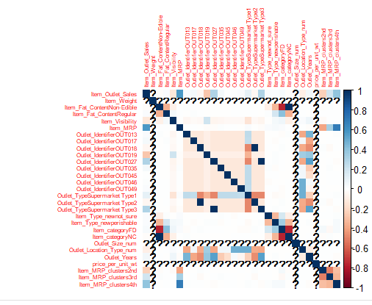
Continue

Slide 8
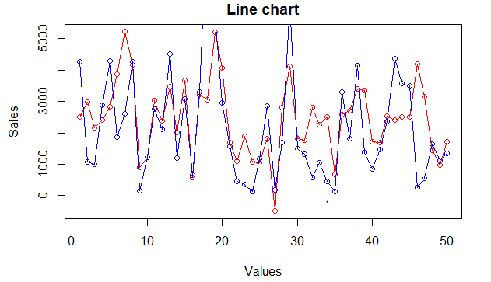
Continue
Linear Regression
Actual vs predicted
RMSE : 1257

Slide 9
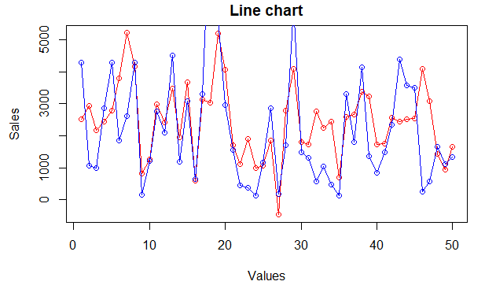
Continue
Lasso Regression
Actual vs predicted
RMSE : 1249

Slide 10
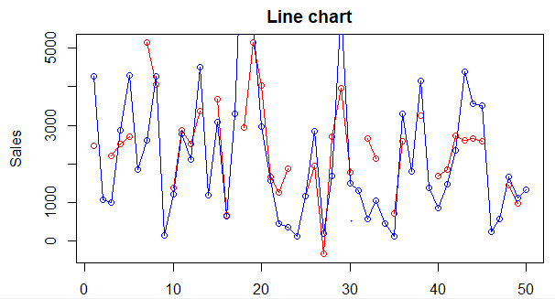
Continue
Ridge Regression
Actual vs predicted
RMSE : 1188

Slide 11
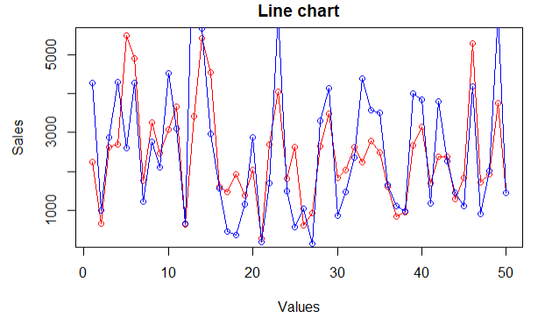
Continue
Random Forest
Actual vs predicted
RMSE : 1158

Slide 12
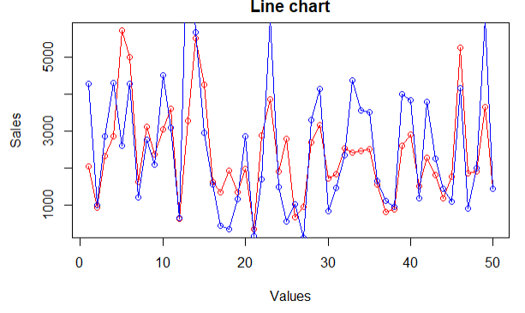
Continue
XGBoost
Actual vs predicted
RMSE : 1169

Slide 13
References
[1] Behera, Gopal & Nain, Neeta.” A Comparative Study of Big Mart Sales Prediction”,ResearchGate.
[2] Rohit Sav, Pratiksha Shinde, Saurabh Gaikwad , “Big Mart Sales Prediction using Machine learning ”, IJCRT
[3] Nikita Malik, Karan Singh, “Sales Prediction Model for Big Mart”, Maharaja Surajmal Institute Journal of Applied Research.
[4] https://courses.analyticsvidhya.com/courses/big-mart-sales-prediction-using-r
[5] https://www.geeksforgeeks.org/root-mean-square-error-in-r-programming/

Slide 14
Thank You

